Slide 1
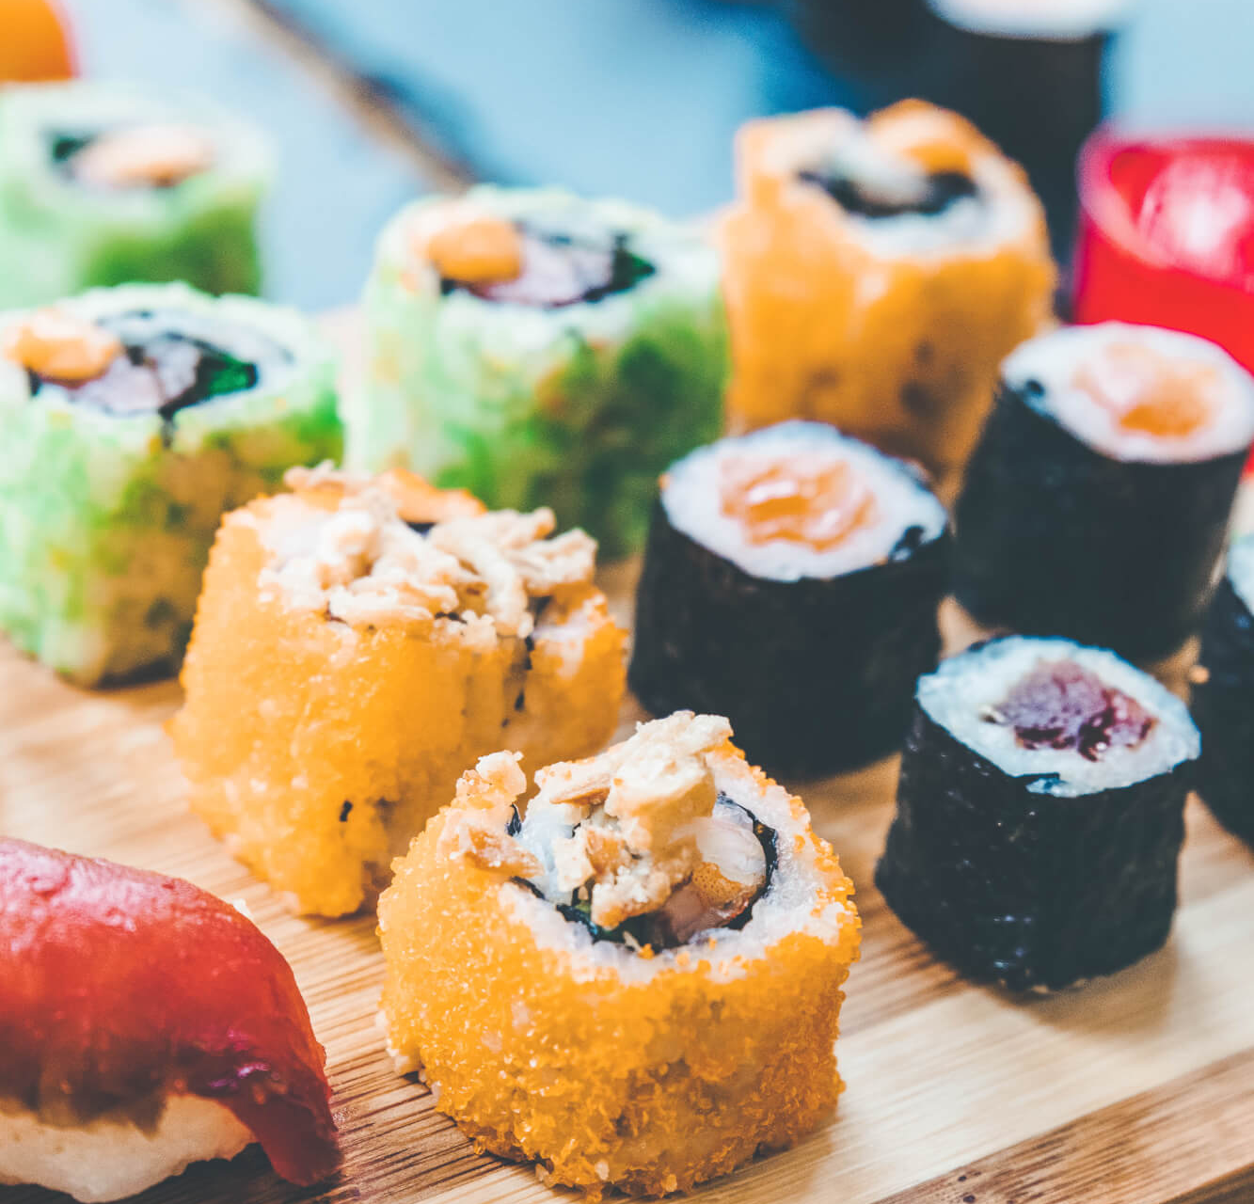
Profiting Restaurants via Personalized Recommendation
Mehak • Shivam • Shubham

Slide 2
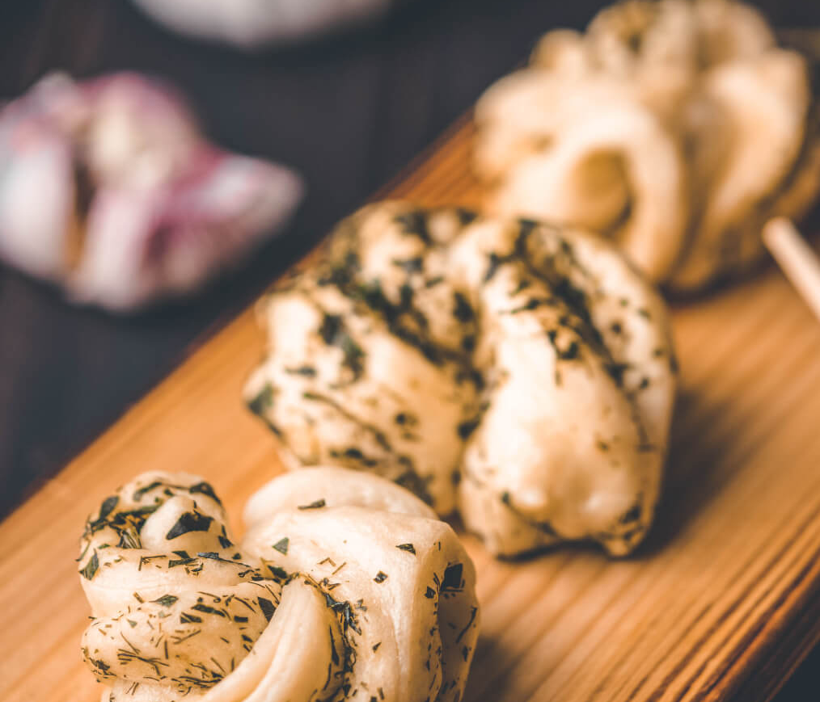
INTRODUCTION
What is the Research Problem?
Is there a way to revamp the menu to avoid spending on less selling dishes?
To find a way to optimize the supply chain for procurement of ingredients.

Slide 3
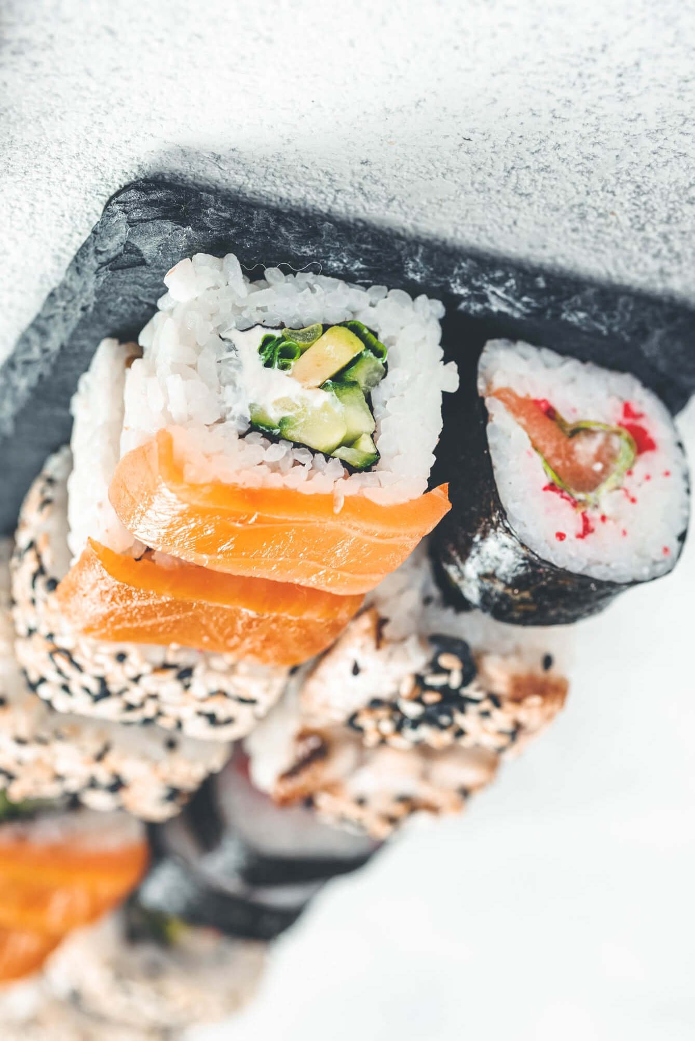
Why is it important?
To help restaurant owners survive the pandemic
Automated solution to keep menu updated with best selling dishes.
Help cooking enthusiasts find a optimal way to procure ingredients from safe locations.

Slide 4
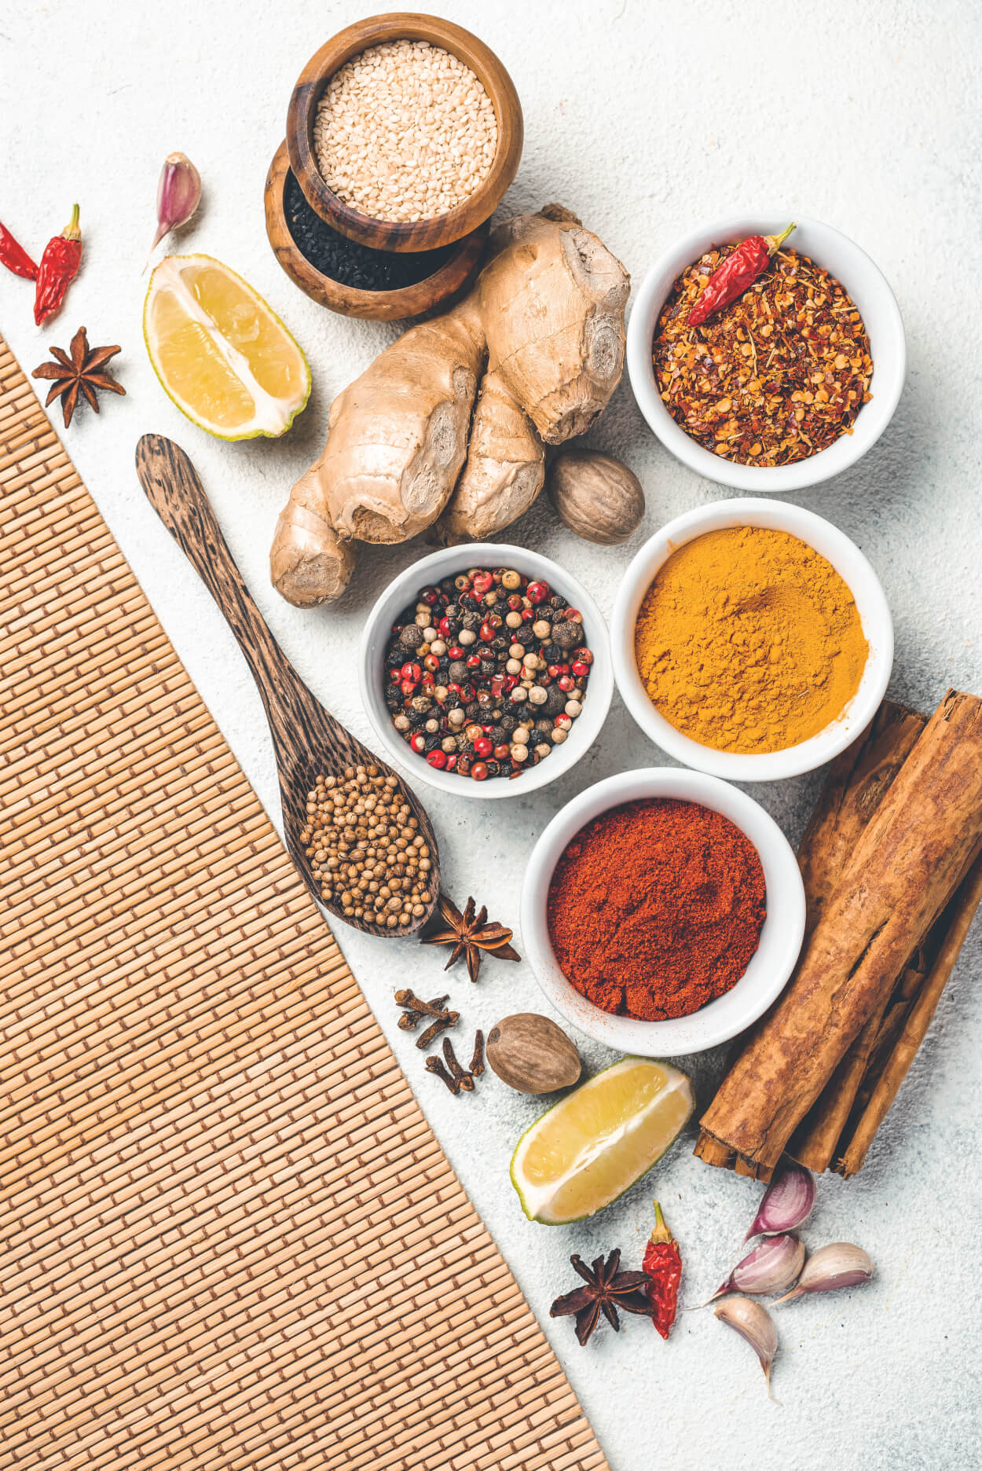
DATA

Slide 5
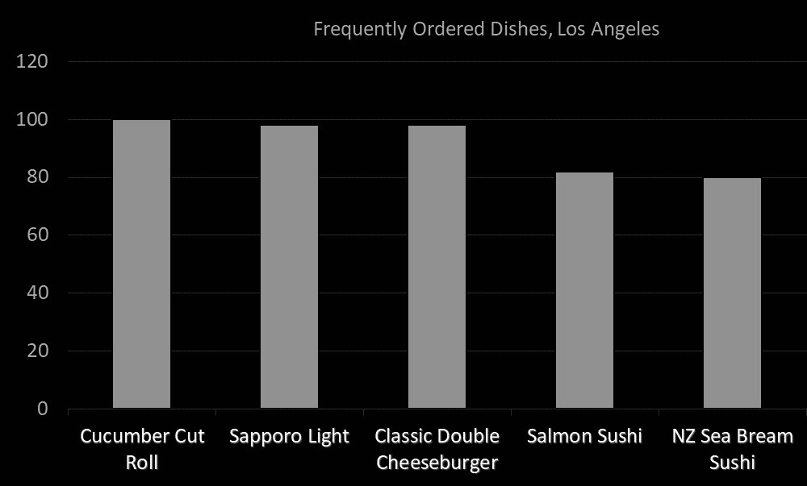
Data Description
Dataset 1
To identify frequently ordered dishes in the Neighborhood, data was scraped from Postmates website.

Slide 6
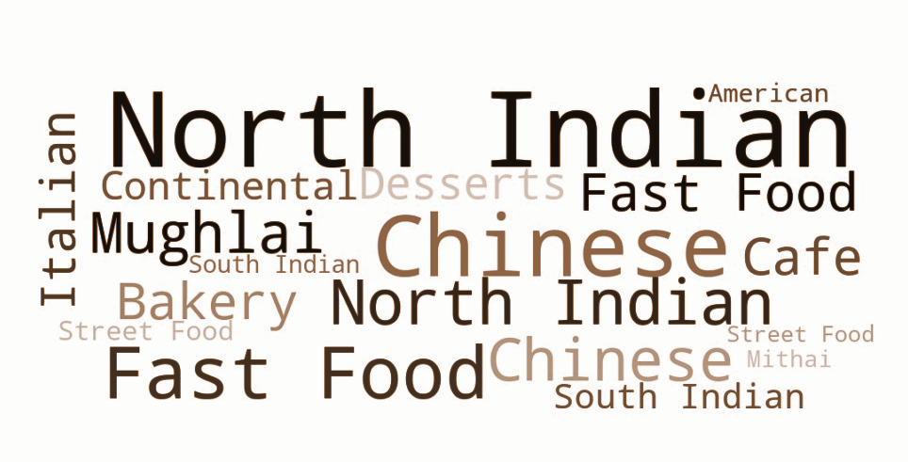
Data Description
Dataset 2
Top-rated dishes belonging to the same cuisine collected through the Zomato API
Word Cloud representing the distribution of various cuisines

Slide 7
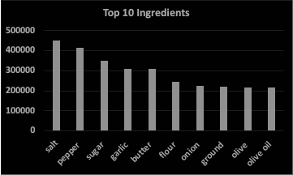
Data Description
Dataset 3
To extract ingredients from the dishes, simplified-recipes-1M Dataset is used.

Slide 8
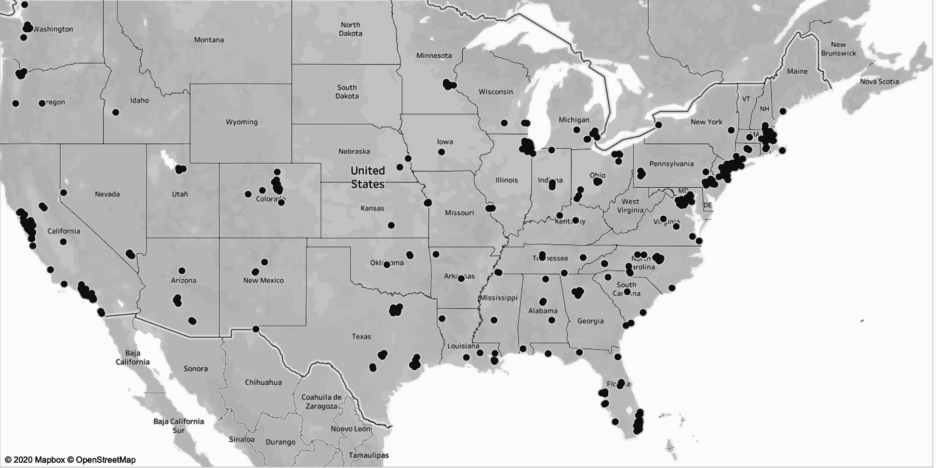
Data Description
Dataset 4
United States Department of Agriculture (USDA) Organic Integrity Database was used.

Slide 9

Methods and Evaluation

Slide 10
Methods and Evaluation
PART A Recommend Dishes to solve user’s purpose
Method:
Content based recommendation system based on cuisine mapping
Item based recommendation for top-rated dishes in the neighborhood.
Evaluation Metric:
Human evaluation via survey form to get ratings

Slide 11
Methods and Evaluation
PART B Extract ingredients and recommend dishes based on extracted ingredients
Method:
Levenshtein Distance is used to calculate the difference between recommended dish and recipe name from ingredients dataset.
Recipes are selected from ingredients dataset with complete overlap on extracted ingredients.

Slide 12
Methods and Evaluation
PART C Supply Chain Path Optimization
Method:
Fetch the ingredients list for the given recipe.
For each ingredient, find the nearest supplier by calculating the euclidean distance between the recipe location and the supplier which has that ingredient available.
The final list of suppliers for the recipe ingredients will be the one with the minimal food mile distance.

Slide 13
RESULTS

Slide 14
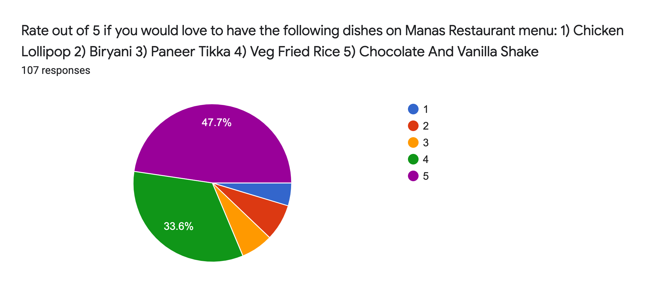
Survey Results
Restaurant 1:

Slide 15
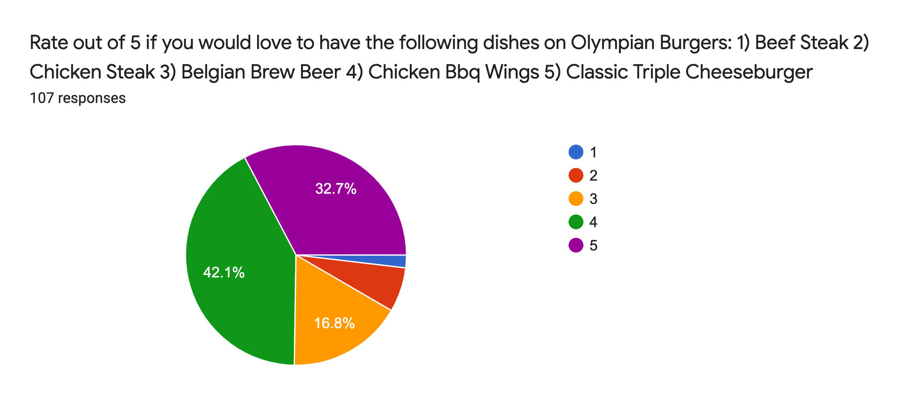
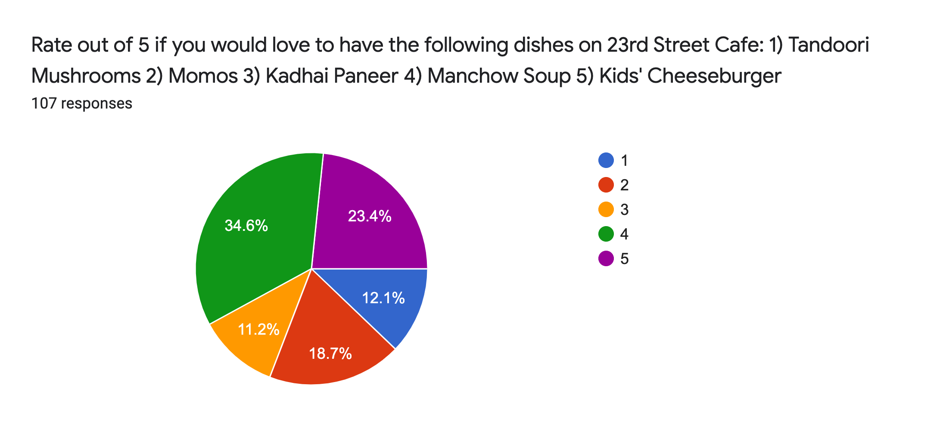
Survey Results
Restaurant 2:

Slide 16
Survey Results
Restaurant 3:

Slide 17
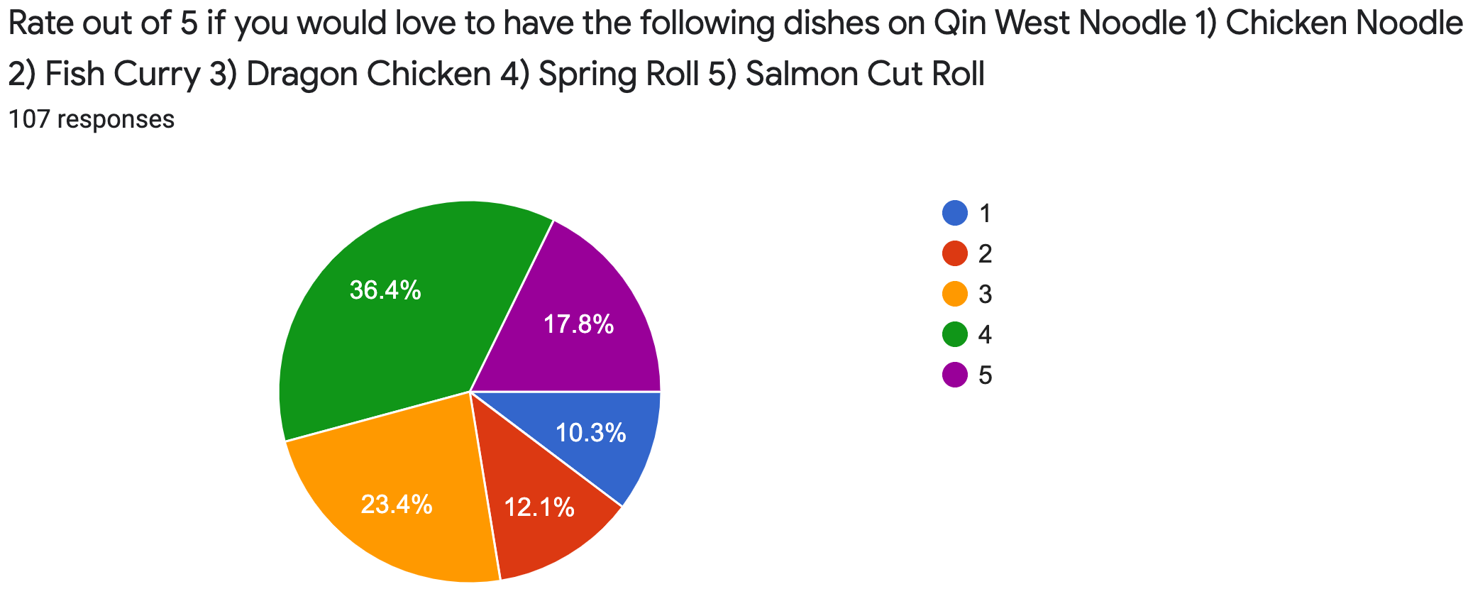
Survey Results
Restaurant 4:

Slide 18
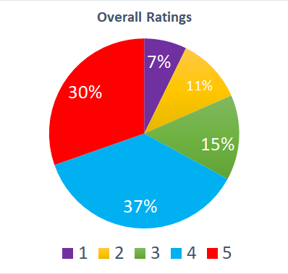
Results
Overall of the
times, the recommended menu items were highly rated by the users than average rating.
82%

Slide 19
Limitations
Challenges with the inconsistencies in the name of the products at different locations.
Limited availability of the ingredients of dishes dataset.
Try editing this text according to your needs

Slide 20
Future Work
To evaluate the supply chain taking into account food miles as well as the cost of the ingredient.
Create a web-app to open-source our findings.
Improve the extensibility of the survey.
Try editing this text according to your needs

Slide 21

THANK YOU !!!

